Slide 1

Apple's 2026 iPhone Lineup
Redefining the Smartphone Experience
Welcome everyone. Today we are looking at Apple's highly anticipated 2026 smartphone lineup. This presentation will cover the newly released iPhone 17 series, outlining the distinct models, performance upgrades, and key innovations that set a new industry benchmark.

Slide 2


The 2026 Product Strategy
Apple has diversified its ecosystem to an unprecedented degree, offering five distinct models ranging from the entry-level 17e to the ultra-premium 17 Pro Max. The core strategy for 2026 is democratizing high-end features—bringing ProMotion and Apple Intelligence to every user.
Apple has shifted its strategy this year, expanding the lineup to 5 distinct models to ensure there is a perfect device for every user and price point. The goal is to bring premium computational features, like Apple Intelligence, down to the standard models without compromising the elite status of the Pro lineup.

Slide 3
Models Overview
Feature | iPhone 17e | iPhone 17 / Air | 17 Pro / Pro Max
Display Size | 6.1" OLED | 6.3" ProMotion | 6.3" / 6.9" ProMotion
Processor | A18 Chip | A19 (3nm) | A19 Pro (3nm)
Camera | Dual 12MP | Dual 48MP Fusion | Triple 48MP Pro System
Build Material | Aluminum | Aluminum / Titanium | Grade 5 Titanium
Base Storage | 256GB | 256GB | 256GB
As you can see in this breakdown, the base models received huge upgrades with standard 256GB storage and 120Hz ProMotion displays. The Pro models continue to push boundaries with the new A19 Pro chip, advanced 48MP triple cameras, and refined titanium chassis.

Slide 4






Key Features & Innovations
Apple Intelligence
Next-Gen Connectivity
ProMotion for All
On-device AI powers smarter Siri conversations, automated email summaries, advanced photo editing, and seamless live language translation.
Equipped with Wi-Fi 7, Bluetooth 6.0, and Apple's new proprietary C1X cellular modem for vastly superior speed and reliability.
The 120Hz ProMotion technology and Always-On display are no longer exclusive to Pro models, delivering fluid scrolling universally.
The key theme this year is Apple Intelligence. With powerful Neural Engines, the devices process AI securely on-device. Coupled with the leap to Wi-Fi 7 and standard Always-On displays, the entire iPhone ecosystem is significantly smarter and more connected than ever before.

Slide 5

Premium Design & Build
•
Ceramic Shield 2: Formulated to be three times more scratch-resistant than previous generations.
•
Titanium Precision: The Pro models feature a refined Grade 5 Titanium frame for weight reduction.
•
Advanced Cooling: A new internal vapor chamber utilizing deionized water optimizes heat distribution.
•
Camera Control: A sleek, capacitive plateau design integrates seamless photography controls into the frame.
Apple continues to refine its premium aesthetic. The standard models retain a robust aluminum frame, while the Pro series uses Titanium. A major internal change is the new vapor chamber cooling system, which ensures the phone stays cool during intensive gaming or video recording.

Slide 6


Performance & Efficiency
A19 Bionic Architecture
•
Built on the cutting-edge 3-nanometer node for extreme energy efficiency.
•
Features a 6-core CPU and up to a 6-core GPU, effortlessly handling AAA gaming titles.
•
Dedicated Neural Accelerators embedded in each GPU core supercharge AI processing.
•
Power optimizations yield up to 30 hours of sustained battery life.
Performance is driven by the 3nm A19 processor family. With increased Neural Accelerators, the phone handles AI tasks instantly without sending data to the cloud. Thanks to these efficiencies, users can experience up to 30 hours of battery life under active use.

Slide 7


Camera Innovations
•
48MP Fusion Systems: Standard models now boast dual 48MP lenses for stunning clarity.
•
Optical Versatility: Pro models offer optical zoom spanning 0.5x to 8x equivalents.
•
Center Stage Selfie: A new 24MP front camera with a square sensor auto-frames subjects in any orientation.
•
Professional Video: Support for Dolby Vision 4K at 120fps, ProRes RAW, and Apple Log 2.
The camera plateau now features a 48MP Fusion setup across the board. The Pro models enhance this with specialized low-light sensors and a massive 8x optical equivalent zoom range. Additionally, the new front camera enables Center Stage directly on the iPhone for perfectly framed video calls.

Slide 8
Pricing & Availability
Model | Starting Price (USD) | Base Storage | Target Audience
iPhone 17e | $599 | 256GB | Entry-level / Budget-conscious
iPhone 17 | $799 | 256GB | Mainstream everyday users
iPhone Air | $899 | 256GB | Minimalists seeking portability
iPhone 17 Pro | $1,099 | 256GB | Photographers & Content Creators
iPhone 17 Pro Max | $1,199 | 256GB | Power Users & Gamers
Pricing remains highly competitive, especially considering the base storage has doubled to 256GB across the entire lineup. The starting $799 price for the iPhone 17 represents incredible value, while the new iPhone Air slots in perfectly for users prioritizing a thin, lightweight design.

Slide 9
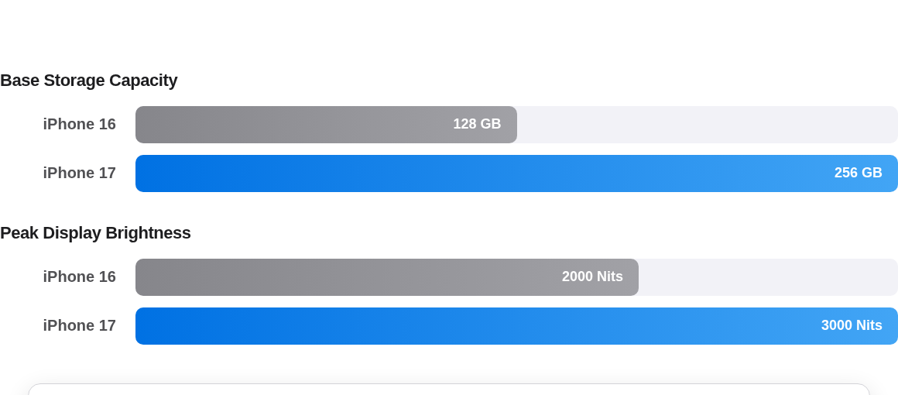
Generational Leaps
Compared to the iPhone 16 series, the leap in base storage (doubling to 256GB) and the massive jump in peak display brightness (reaching 3000 nits) provide one of the best generational upgrades we've seen in years, ensuring the device is fully future-proof.

Slide 10

Pros & Cons
Strengths (Pros)
Limitations (Cons)
•
Double the base storage (256GB) at no extra cost.
•
Premium pricing on the Pro Max remains high.
•
Slight learning curve for the new Camera Control.
•
ProMotion 120Hz display now on standard models.
•
The highly anticipated foldable model is delayed.
•
Vastly improved thermal management for gaming.
•
Design language remains iterative rather than revolutionary.
•
Deep integration of Apple Intelligence features.
While the pros vastly outweigh the cons, it's important to note the Pro Max price tag and the delay of the foldable iPhone until 2027. However, the inclusion of a 120Hz display on the baseline iPhone 17 makes it a monumental upgrade for the average consumer.

Slide 11
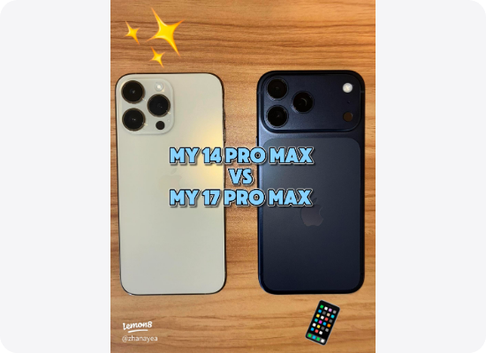
Buying Recommendations
•
For Students: The iPhone 17e offers exceptional value, Apple Intelligence, and a solid camera for everyday use.
•
For the Mainstream: The iPhone 17 is the sweet spot, featuring Pro-level displays and 48MP cameras.
•
For Minimalists: The iPhone Air delivers flagship power in an ultra-sleek, lightweight chassis.
•
For Creators & Pros: The 17 Pro series provides unparalleled video recording, optical zoom, and processing power.
To summarize our recommendations: The 17e is excellent for students on a budget. The standard 17 hits the sweet spot for 80% of users. The Air is perfect for those who want a thin, light phone, while the Pro models remain the undisputed kings for digital creators.

Slide 12

Questions?
Thank you for exploring the future of iPhone with us.
Explore more at apple.com/iphone
Thank you for your time. Are there any questions about the 2026 iPhone lineup, Apple Intelligence, or the new pricing structures?

Slide 13





Image Sources
https://images.stockcake.com/public/a/9/5/a9516ede-fb82-4d26-abf9-139a978630b2_large/sleek-smartphone-design-stockcake.jpg
Source: stockcake.com
https://images.stockcake.com/public/7/7/2/772d956b-0926-4b6b-b106-c0aa00bb994b_large/vibrant-neural-network-stockcake.jpg
Source: stockcake.com
https://petapixel.com/assets/uploads/2025/10/vivo-x300-pro-review-featured.jpg
Source: petapixel.com
https://www.lemon8-app.com/seo/image?item_id=7557807091847725599&index=0&sign=f5784aa753ed0fa6ae869c7f55088ad7
Source: www.lemon8-app.com
https://www.chromaticlabs.co/_next/image?url=https%3A%2F%2Fraoyzjobgmmlsiydiylt.supabase.co%2Fstorage%2Fv1%2Fobject%2Fpublic%2Fpublic_bucket%2Fstoryboard-assets%2F938e255e-eb58-481a-ba98-c5348a5b194e%2F3d8ff730-18d8-4b97-8603-39ca9969f038%2F1772297583815-e5d779f8-9442-4989-a49d-103611d0b764.png&w=3840&q=75
Source: www.chromaticlabs.co

